Slide 1
SAS Capstone Project
By Subhranil Roy

Slide 2
Objectives:
* What are the top factor driving churn at Mobicom
* What will be the proactive retention plan to minimize churn
*Who are the high revenue customers.
* What will be the targeted segment for marketing camping

Slide 3
Churn Rate at Mobicom
Recent churn rate at Mobicom is 23.8%.

Slide 4
The top five factors driving likelihood of churn at Mobicom
* Age of the current equipment- Positively correlated with churn.
* Retention calls: The customer who are not received any retention calls are more likely to churn.
* Non Optimal rate plan-The subscriber who are on non optimal plan are more likely to be churn.
*Unique Subscriber- Churn rate is depending on number of unique subscriber in house hold.
*Number of months in service- Months is negatively related with churn.

Slide 5
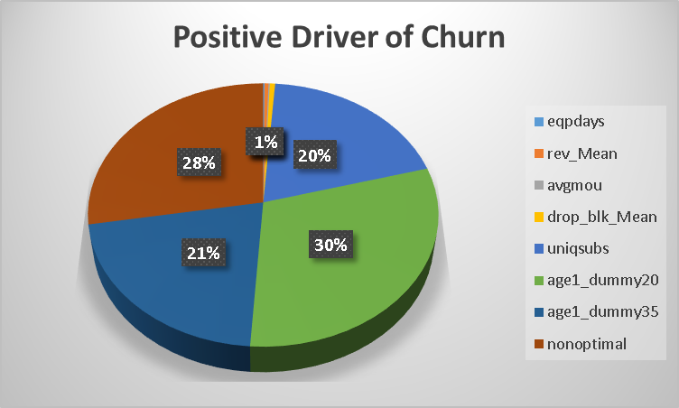
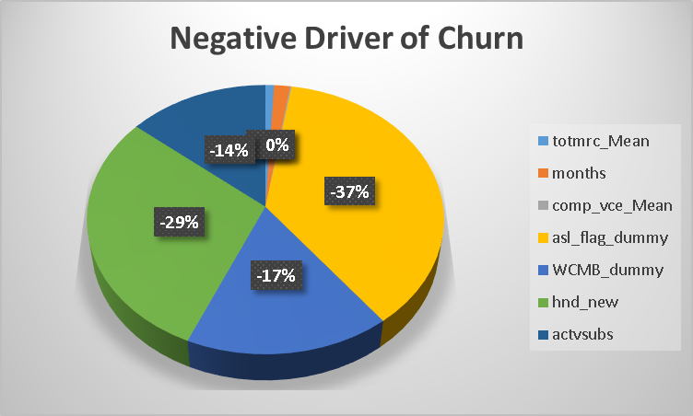

Slide 6
Validation of survey findings
*With increase of mean of monthly revenue the probability of churn is also increase marginally. So ‘cost and billing’ is not very important but it is some how leading to churn. It has very little effect to churn. For unit increase of revenue probability of churn is increase by 0.2%.
*Data usage quality has no direct influence on churn but over all dropped and blocked voice and data call causes churn. Probability of churn for this case is increase by 0.3% for unit increase of voice and data drop and block calls.
*Data usage connectivity does not directly leading to churn.

Slide 7
Rate plan migration as a proactive retention strategy
* The churn rate for the non optimal plan customer is very high. Probability of churn is increase by 20 % for non optimal rate plan customers. So Rate plan migration will be a very important proactive retention strategy.

Slide 8
Recommendation for prioritisation of customers for a proactive retention campaigns in the future
*Family bundle plane- increasing number of active subscriber in household is negatively correlated with churn so family bundling plane will play a key role to retain the customer.
*Optimal rate plane migration- Bring the non optimal rate plane customer into optimal rate plane. From the model it is clear that the factor non optimal plan is directly driving to churn.
* The customer whose age are less than 35 are more likely to churn. This customers are need spatial focus for proactive retention plan.
*Over all network quality need to be improve to retain customer.
*No of month the customer is using the service is negatively correlated to churn. Implement plane like loyalty bonus plan for them to attract the new customer to stay long with Mobicom.
* Customers from rural and town are also likely to churn than the customer form other area. Rural and town area should get more focus on proactive retention plan.

Slide 9
Target segments for proactive retention campaigns
*About 10000 customer are there from
whom Mobicom receive 65% more
average revenue than the general population.
*Mean no of blocked and dropped voice and
data calls for these customers are 95% higher
than the population.
*Mean no of complain called received by
Mobicom from these customer are also 90%
higher than the population.
*These will be the most important first
target segment for proactive retention
plan.
*Churn rate of these customers are 22.89%.

Slide 10
Thank You

